Slide 1

Current topics in Machine Learning: Advanced Concepts in ML
Hyperparameter Tuning in ML

Slide 2

Source
Source and for more details:
https://github.com/ahoirg/HyperParametersTuning__PresentationAndMaterials

Slide 3

Agenda
Introduction
Motivation
Hyperparameter Optimization Techniques
References

Slide 4
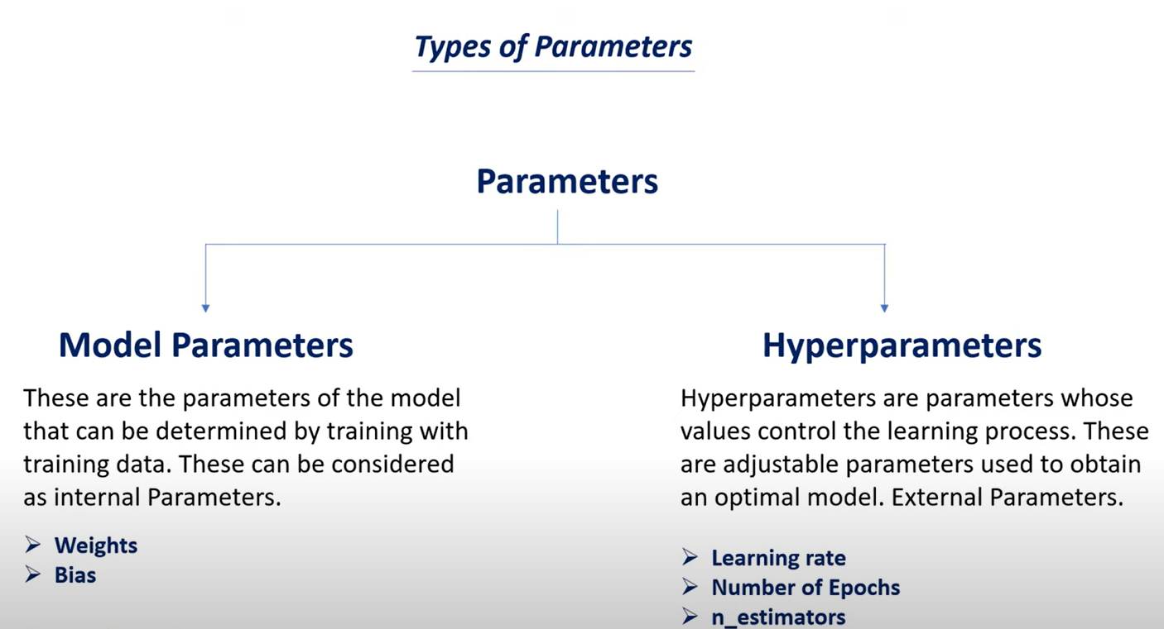
Parameter Types in Machine Learning
https://www.youtube.com/watch?v=DTcfH5W6o08
Notes:
Model parameters are internal configuration variables.
These parameters are optimized by the model.
Hyperparameters are external configuration variables
We use hyperparameters to manage the learning process of ml model.
They directly affect the performance of the ml modal.
Hyper-parameters, cannot be estimated from training data by the modal

Slide 5
Hyperparameter Types
Continuous Hyperparameter:
It can take any real-numbered value within a specified range.
e.g Learning Rate: [0,1]
Discrete Hyperparameter:
Discrete hyperparameters can only take specific separate values.
e.g number of layers in a neural network :[1,2,3,4,…]
Categorical Hyperparameter :
Categorical hyperparameters are not numeric
e.g kernel type in a support vector Machine : 'linear', 'poly', 'rbf', 'sigmoid', etc..
Conditional Hyperparameter:
Parameters that are set based on the values of other hyperparameters.
e.g the degree of the polynomial kernel function needs to be tuned when the kernel type is polynomial
Notes:
Hyper-parameters are classified as continuous, discrete, categorical and Conditional.

Slide 6
Hyperparameter Tuning
The process of designing the ideal model architecture with an optimal hyper-parameter configuration is named hyperparameter tuning.
Hyperparameter Tuning: This is the process of manually or systematically choosing the right hyperparameters for a ml model
But selecting the best hyperparameters is a complex task due to the large number of options and their complex interactions.
Some hyperparameters example: Number of layers, number of kernels in each layer, activation function in each layer, number of dense layers, batch size, learning rate

Slide 7
Hyperparameter Tuning - Hyperparameter Optimization
Manual tuning is ineffective for many problems due to some factors:
large number of hyperparameters,
complex models
time-consuming model evaluations
non-linear hyper-parameter interactions
These factors have inspired increased research in techniques for automatic optimization of hyper-parameters; Hyperparameter Optimization

Slide 8
The hyperparameter optimization process
Every time a hyper-parameter value is tested:
the entire ML model needs to be retrained
the validation set needs to be processed to generate a score that reflects the model performance
4 main components of HBO process:
An estimator with its objective function
A search space (configuration space)
A search or optimization method
An evaluation function

Slide 9
Agenda
Introduction
Motivation
Hyperparameter Optimization Techniques
References

Slide 10
Motivation
Finds the best combinations in the hyperparameters space;
improves model performance,
increases accuracy,
reduces overfitting
optimizes training time
Choosing the best hyperparameters is not easy. There are many options, and it's hard to know which one is the best without trying
Hyperparameter optimization techniques help us test different hyperparameters quickly and find the best ones.

Slide 11
Agenda
Introduction
Motivation
Hyperparameter Optimization Techniques
References

Slide 12
Hyperparameter Optimization Techniques
Model-free algorithms
Babysitting
Grid search
Random search
Bayesian optimization
BO-GP
Multi-fidelity optimization algorithms
Successive halving
Hyperband
Genetic algorithm

Slide 13
Babysitting
Also called ‘Trial and Error’
It is the simplest method where hyperparameter combinations are selected manually.
Hyperparameter values ​​are chosen by trial and error
Implemented by 100% manual tuning
Manual tuning is infeasible for many problems due to several factors;
a large number of hyper-parameters
complex models
time-consuming model evaluations
non-linear hyperparameter interactions

Slide 14
Babysitting
Advantages:
Simple and understandable.
Suitable for only small number of hyperparameter combinations.
Disadvantages:
Time-consuming.
May not be effective.
Not effective for models that have high number of hyperparameter combinations

Slide 15
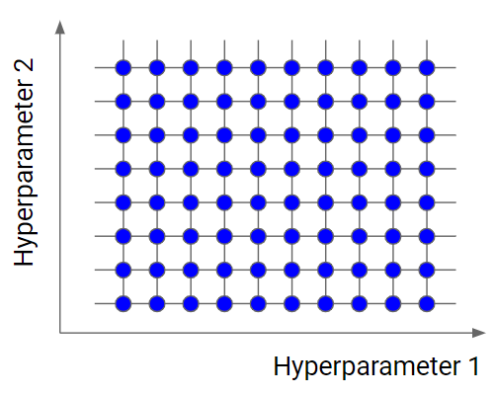
Grid Search
Brute-Force approach (Exhaustive Search)
Try all possible combinations of hyperparameters
Creates a grid between specified hyperparameter values.
Evaluates the Cartesian product of a user-specified finite set of values
Need to convert Continuous Hyperparameters to Discrete Hyperparameters. (eg: define an increment value)
https://www.yourdatateacher.com/2021/05/19/hyperparameter-tuning-grid-search-and-random-search/

Slide 16
Grid Search
Advantages:
Provides a comprehensive search.
-->no possibility is ruled out
Can be effectively parallelized.
Easy to implement
Disadvantages:
Costly for large hyperparameter spaces.
Example: 6 hyperparameters and each has 10 values => Must try 10⁶ combinations
No guarantee of finding the best solution.
Not smart

Slide 17
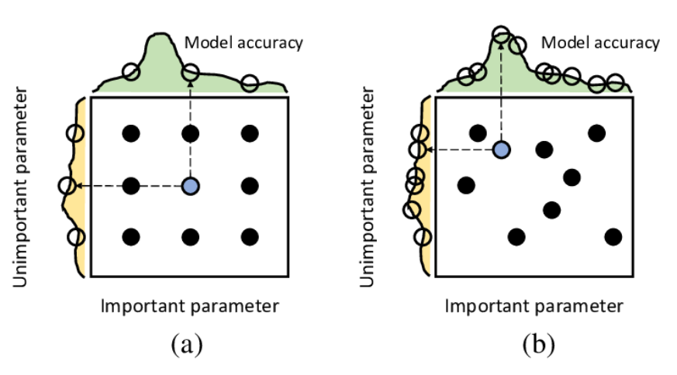
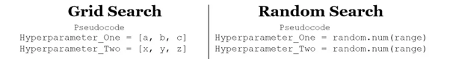
Random Search
Trying randomly selected combinations in hyperparameter space.
Randomly selects a pre-defined number of combinations between the upper and lower bounds
No need to define the increment value.
->allowing for exploration of a broader search space
Random Search for Hyper-Parameter Optimization James Bergstra JAMES.BERGSTRA@UMONTREAL.CA Yoshua Bengio YOSHUA.BENGIO@UMONTREAL.CA

Slide 18
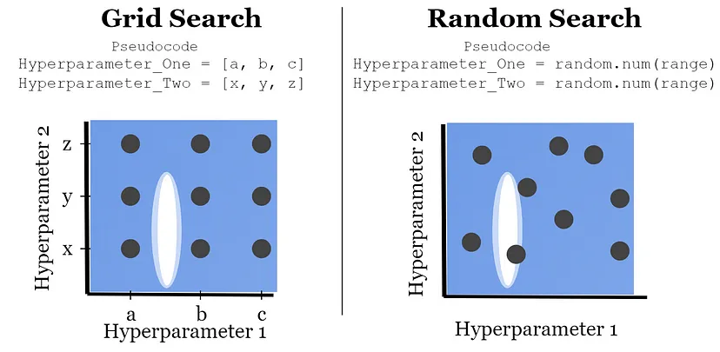
Randomiz Search
Advantages:
Less costly.
Flexible and scalable.
Disadvantages:
Less comprehensive than grid search.
Not smart
No guarantee of an optimal solution.
https://medium.com/@jackstalfort/hyperparameter-tuning-using-grid-search-and-random-search-f8750a464b35

Slide 19
An Experiment: Grid Search Vs Random Search
Experiment Purpose:
Aimed to compare the results and performances of different hyperparameter optimization methods (GS and RS).
Comparing hyperparameter optimization for a CNN model running on the MNIST dataset.
It contains black and white images of handwritten numbers (0 to 9) (28x28 pixels)
Some Details:
A simple CNN model was defined. This model was trained with different combinations of hyperparameters.
Hyperparameters (learning rate, number of filters, kernel size, dense units) were determined. A total of 24 different combinations were created.
GS: Tried all combinations of hyperparameters and recorded the performance of each.
RS: Tried 10 randomly selected combinations of hyperparameters and recorded their performance.
Notes:
I tried to compare GS and RS
All hyperparameters have discrete values.
So there is no continues hyperparameters or categorical hyperparameters.
Theoretically, if the search space is large enough, RS can find the combination that gives optimal performance, or close to optimal performance.
Modified National Institute of Standards and Technology database
RS can test the number of combinations we determine.
RS will consume less time and resources than Gs. But can he find the combination that gives optimum performance?

Slide 20
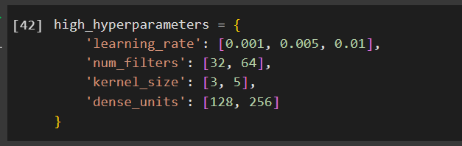
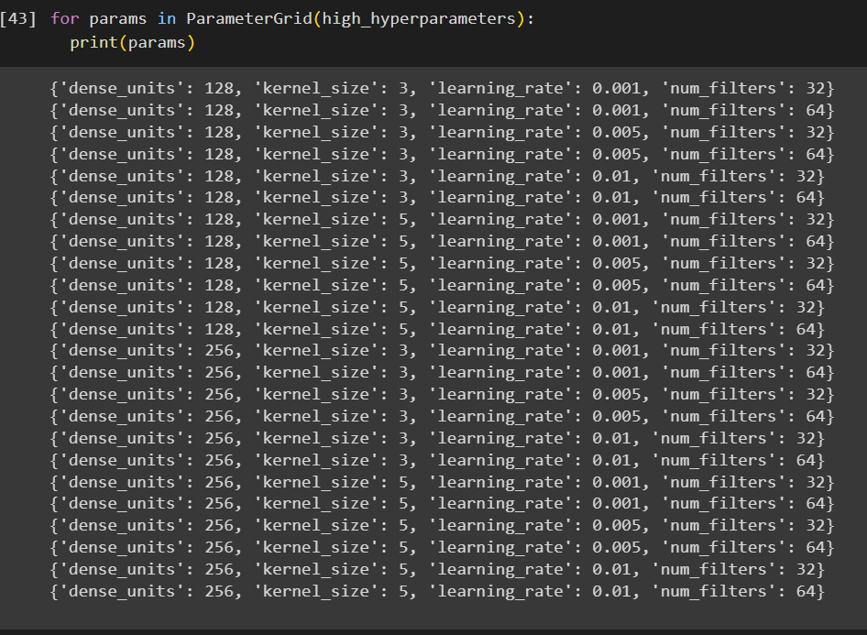
Grid Search Vs Randomized Search
24 Combinations

Slide 21
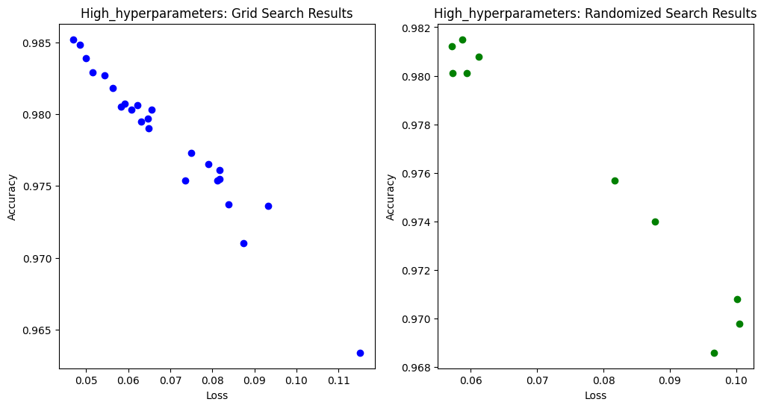
Grid Search Vs Randomized Search
24 points
10 points
Notes:
Accuracy and loss function table -> The best result is 0.985 accurancy
Gs tried 14 combinations that gave accuracies below 0.98.
Rs only tried 5 combinations that gave accuracies below 0.98.
the RS tries fewer combinations in underperforming areas compared to the GS.

Slide 22
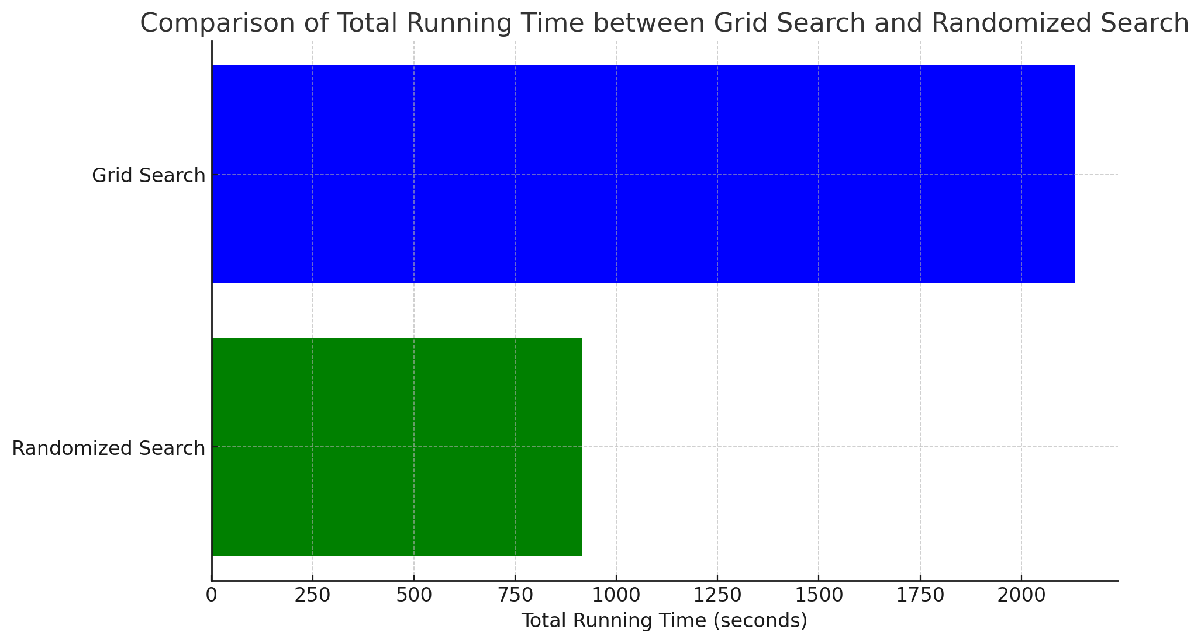
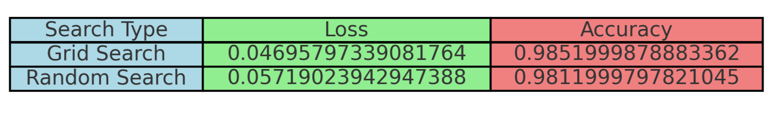
Grid Search Vs Randomized Search
≈ 35.53 min.
≈ 15.25 min.
Notes:
With grid search, the process took 35 minutes.
With Random search, process took 15 minutes.
And both of them found combinations with almost the same performance.

Slide 23
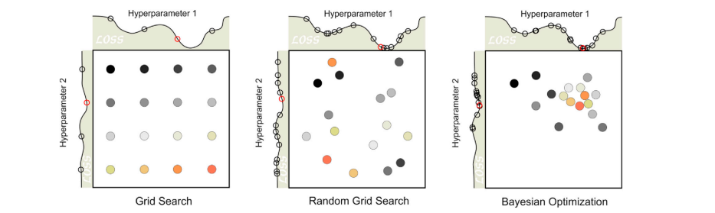
Bayesian Optimization
The colour gradient of the points, from black to yellow to orange indicates the order of the search.

Slide 24
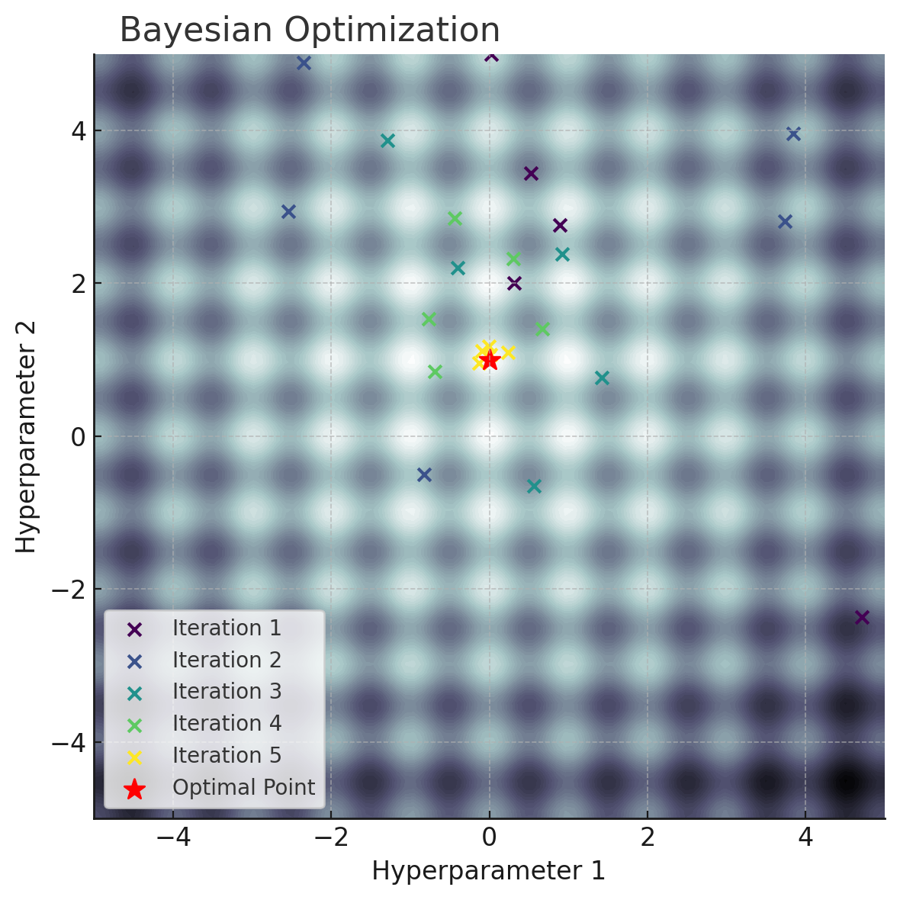
The points in the last iteration are clustered around the optimal point.

Slide 25
Bayesian Optimization
Iterative algorithm
BO makes new selections in the search space based on previously obtained results
To determine the next selection, BO uses two key components:
a surrogate model
an acquisition function
A surrogate Model
It is used to make predictions about the objective function's behavior.
Common surrogate models: Gaussian process (GP), Random forest (RF) , The tree parzen estimator (TPE)
2. The acquisition Function
The acquisition function determines which combination of hyperparameters should be tried next.
trade-off between exploration and exploitation

Slide 26

Bayesian Optimization
Principles that guide the strategy of the algorithm:
Exploration: This means trying new combinations in areas that have not yet been sufficiently sampled
Exploitation: This is a strategy to more intensively test combinations of hyperparameters that have been observed to give good results so far.

Slide 27
Surrogate Model Type 1: BO-Gaussian Process
Gaussian process (GP) is a standard surrogate model for objective function modeling in BO
Each newly-tested data point is added to the sample records, and the BO-GP model is re-built with the new information.
This procedure is repeated until termination step

Slide 28
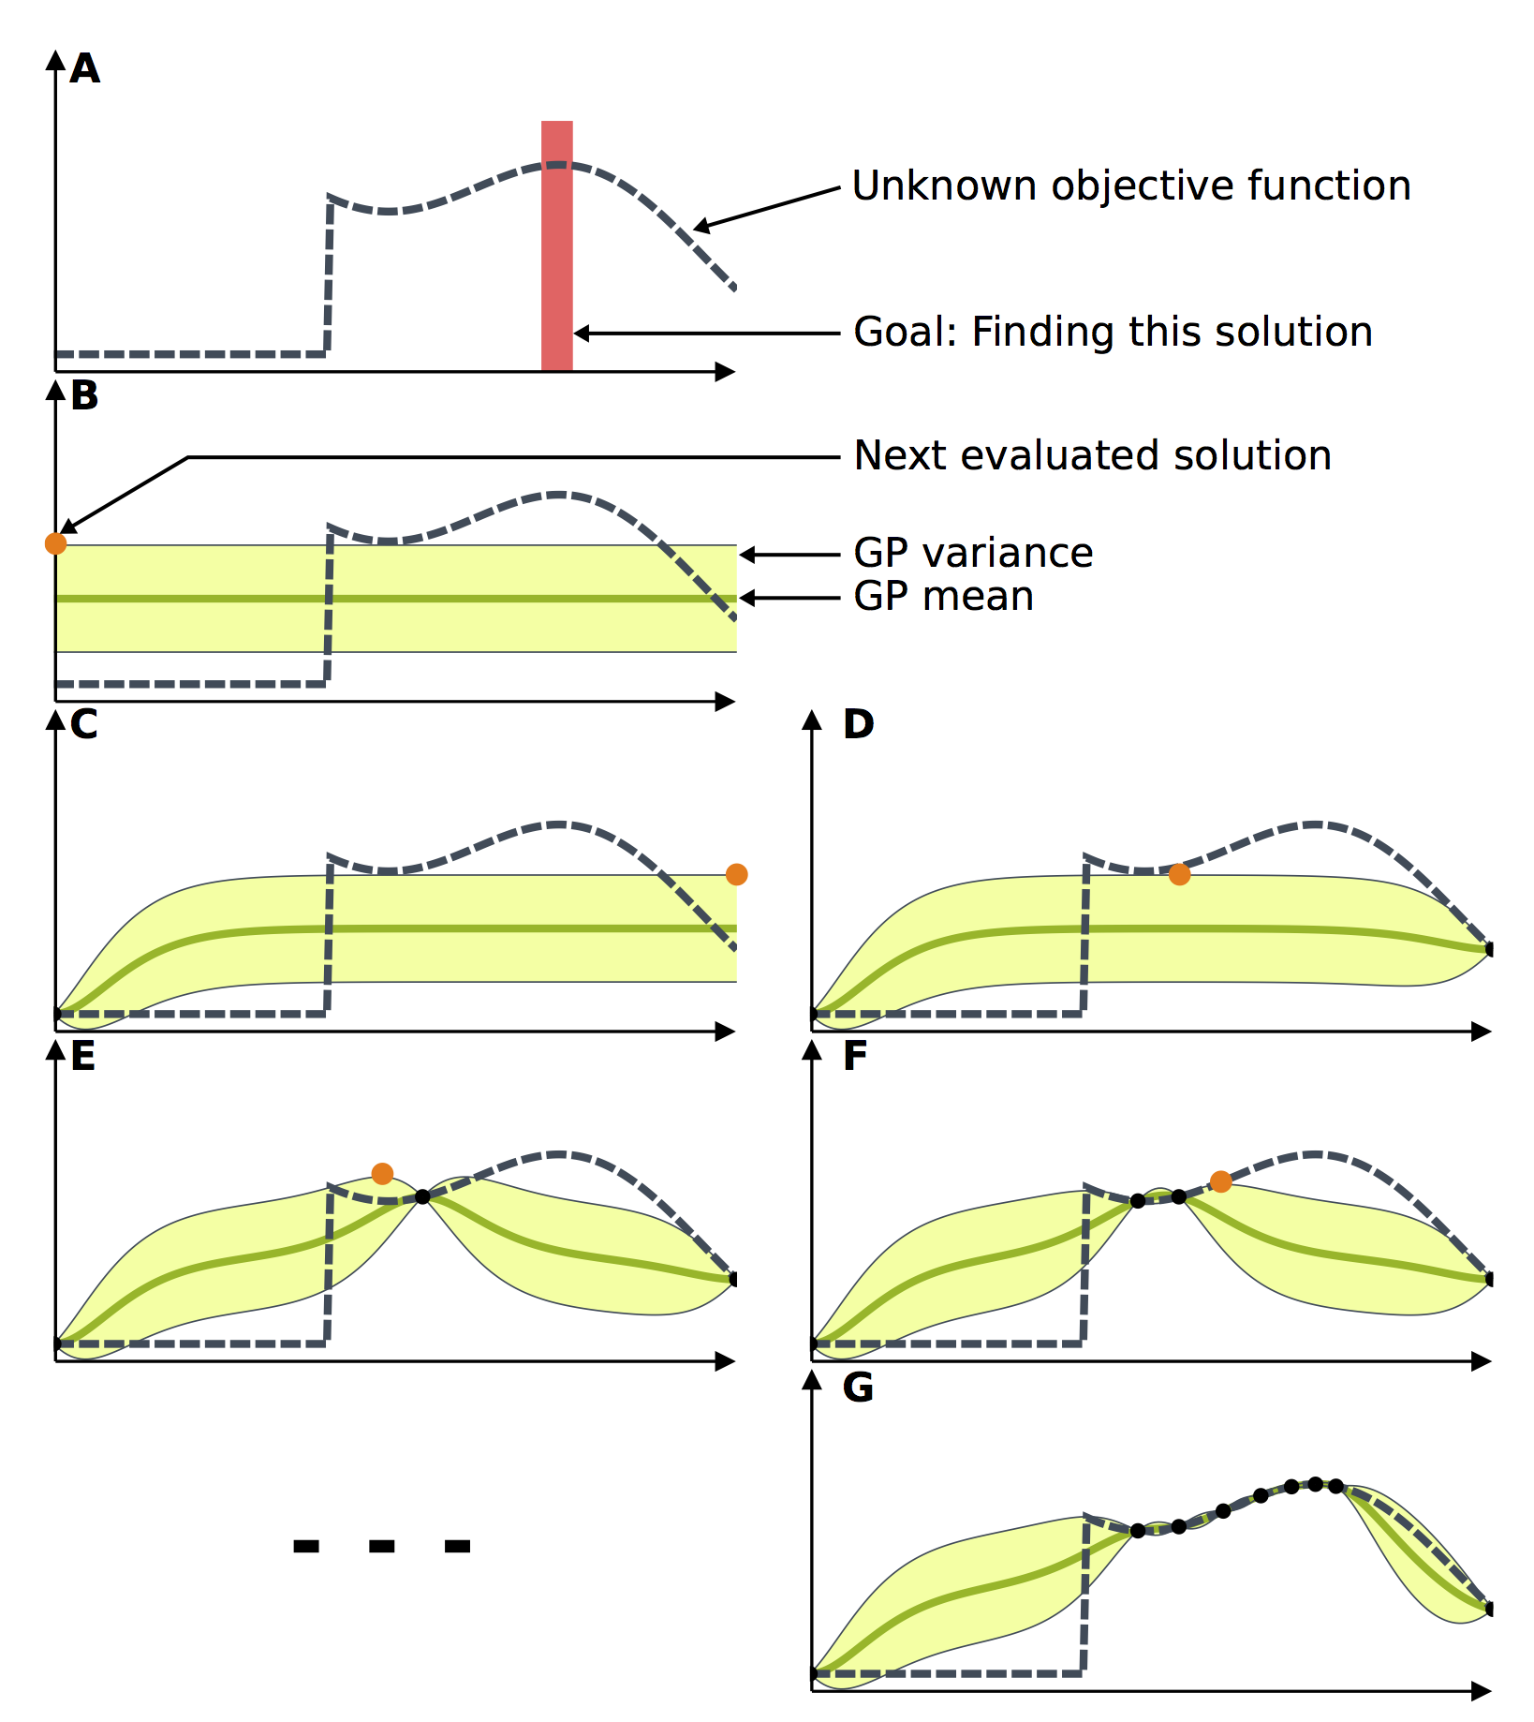
Type 1: BO-Gaussian Process
The goal of this toy problem
is to find the maximum of the unknown objective function.
(B) The Gaussian process is initialized, as it is customary, with a constant mean and a constant variance.
(C) The next potential solution is selected and evaluated. The model is then updated according to the acquired data.
(D) Based on the new model, another potential solution is selected and evaluated.
(E-G) This process repeats until the maximum is reached.
https://resibots.eu/limbo/guides/bo.html

Slide 29
Bayesian Optimization
Advantages:
Smart
Better results with fewer trials.
Disadvantages:
Involves complex mathematical algorithms.
May not be effective for small datasets.
Only partially parallelizable
Need to choose hyper-hyper parameters
choice of acquisition function
choice of covariance kernel function ( for GP)
knobs in exploration-exploitation trade-off
There is a risk of getting stuck in local optimum
Notes:
It can detect the optimal hyperparameter combinations by analyzing the previously-tested values.
Running a surrogate model is often much cheaper than running the entire objective function.
It must wait for the results of the combinations in iteration 1 to start iteration 2.
We use optimization algorithms that tune the hyperparameters of the model to achieve better performance.
To get better performance from optimization algorithms, we need to tune the parameters of optimization algorithms.
we need to set hyper-hyper parameters.
We must set the hyper-hyper parameters correctly. There is a risk of getting stuck at local optimum.

Slide 30
Successive Halving
In theory, exhaustive methods can identify the optimal hyper-parameter combination by evaluating all combinations in search space.
BUT, In practice there are some limitations.
→ limited time → limited resources (They are called Budget (B))
Exhaustive methods such as GS and RS cannot overcome these limitation.

Slide 31
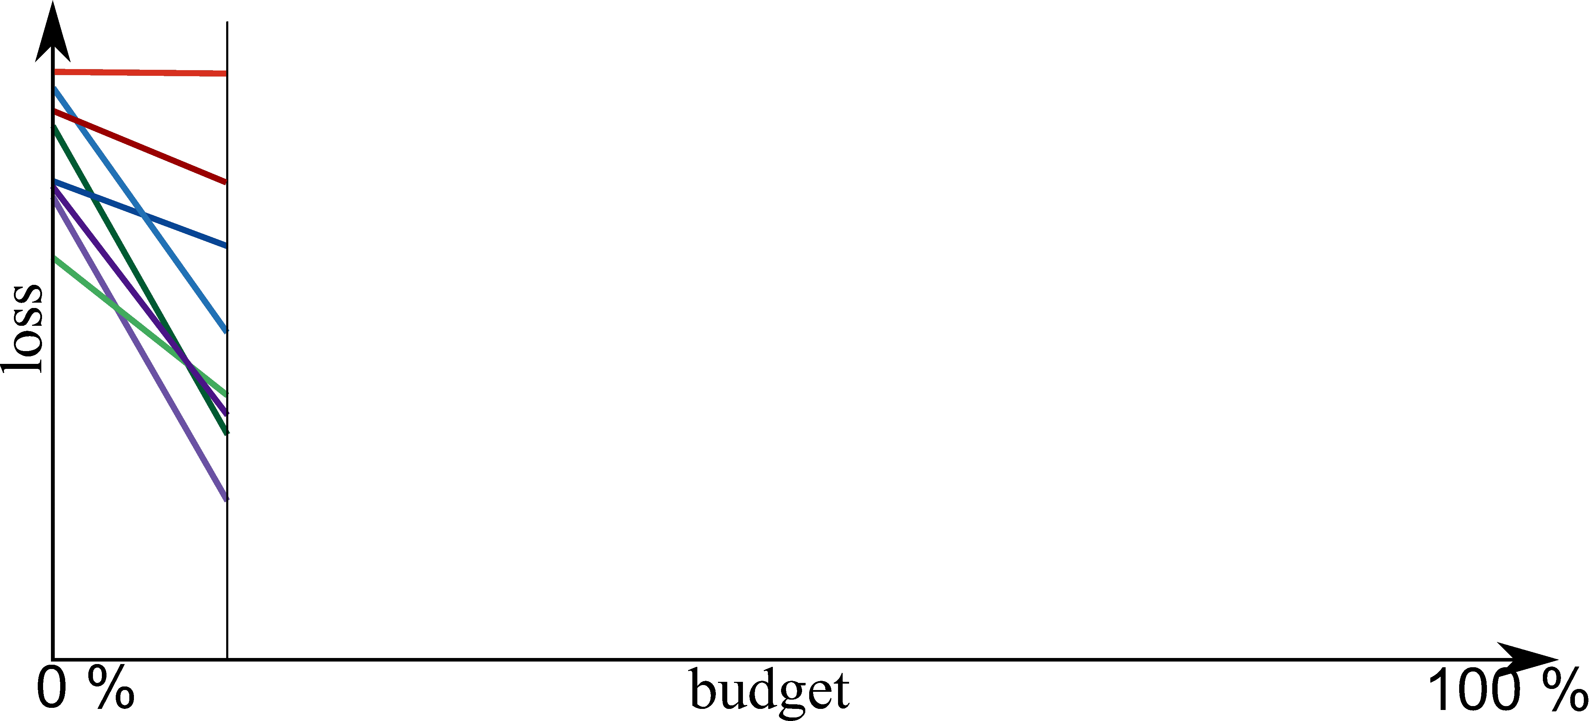
Successive Halving
https://www.automl.org/blog-2nd-automl-challenge/

Slide 32
Successive Halving
Main processes in Successive halving:
Suppose there are ‘’n’’ combinations of hyperparameters:
Combinations are evaluated with uniformly-allocated budgets (b = B\n).
Then, according to the evaluation results for each iteration:
The poorly-performing half is eliminated.
The better performing half is passed to the next iteration with double budgets (b_{i+1} = 2 * b)
3. Repeat the process until the final optimal hyper-parameter combination is detected.

Slide 33
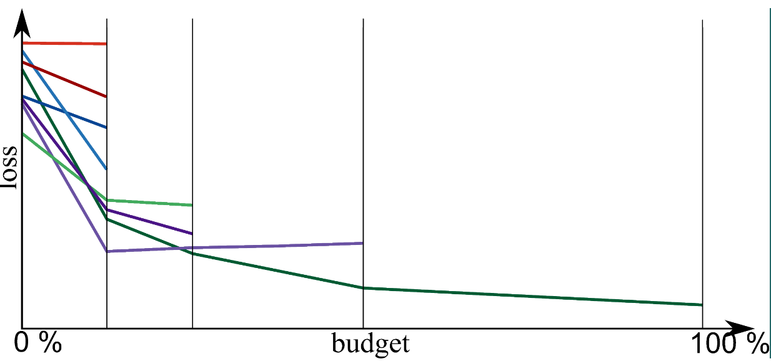
Successive Halving
https://www.automl.org/blog-2nd-automl-challenge/

Slide 34
Successive Halving
Advantages:
Efficiency: rapid testing of many combinations
Resource Optimization: It eliminates low-performing combinations
Simplicity and Applicability: The algorithm is relatively simple and easy to implement.
Disadvantages:
Importance of Hyperparameter Distribution: If good combinations are not chosen initially, it may not produce the best results.
Risk of Early Elimination
Tuning Required

Slide 35
Hyperband
Hyperband is proposed to solve the dilemma of successive halving by dynamically choosing a reasonable number of configurations.
Trials with Different Budgets:
Do several experiments with different budgets.(e.g., short, medium, and long training durations).
Applying Succussive Halving:
Apply the Succussive Halving algorithm for each trial.
Each trial starts with a different number of initial configurations and budgets.
Performance Evaluation:
In each iteration of Succussive Halving, select the best-performing configurations.
Determining the Best Configurations:
Determine the overall best hyperparameter set by comparing the best configurations from trials with different budgets.

Slide 36
Hyperband variants
Still initial combinations are selected randomly in Hyperband.
We can use Bayesian Optimization algorithm instead of Random Search.
This algorithm is called Bayesian Optimization Hyperband (BOHB).

Slide 37
Metaheuristic Algorithms
Notes:
These algorithms are inspired by biological theories.

Slide 38
Genetic Algorithm
Based on evolutionary theory
The next generation will also inherit their parents’ characteristics and may involve better and worse individuals.
→ Better individuals will be more likely to survive and have more capable offspring
→ The worse individuals will gradually disappear.
After several generations, the individual with the best adaptability will be identified as the global optimum.
Notes:
Since the randomly-initialized parameter values often do not include the optimal parameter values, several operations, including selection, crossover, and mutation operations, must be performed on the well-performing chromosomes to identify the optimums.
Chromosome selection is implemented by selecting those chromosomes with good fitness function values.
To keep the population size unchanged, the chromosomes with good fitness function values are passed to the next generation with higher probability, where they generate new chromosomes with the parents’ best characteristics.

Slide 39
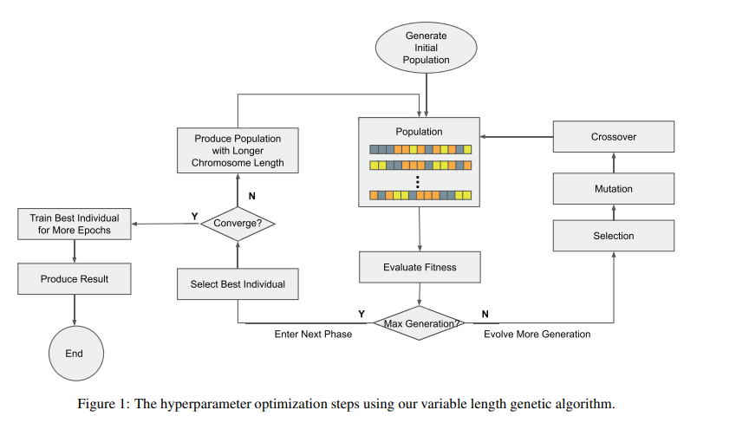
Genetic Algorithm
Efficient Hyperparameter Optimization in Deep Learning Using a Variable Length Genetic Algorithm Xueli Xiao, Ming Yan, Sunitha Basodi, Chunyan Ji, Yi Pan
Notes:
1) It create the initial population. Each individual in the population has randomized hyperparameters
2) Evaluate the each individual in the current generation.
3) Sort each individual according to their results.
4) Choose the n best individuals. (Select as many good individuals as the user specifies.)
5) Apply mutation and crossover operations.
6) Repeat until the given number of generations or iterations is reached.
7) Check whether the algorithm meets the convergence criterion. If the algorithm has not converged, the population will be modified.
longer chromosome length or increasing the range of hyperparameters value.

Slide 40
Genetic Algorithm
Advantages:
Effective in large search spaces
Robust Operations: The selection, crossover, and mutation operations in GA reduce the risk of missing the global optimum.
Flexibility and Generalizability: They can be applied to a wide variety of problems.
Disadvantages:
Need to set hyper-hyper parameters population size, mutation rate, crossover rate, etc.
Time Complexity: O(n2)
Computational Cost: Especially for large-scale problems, it can be computationally expensive.

Slide 41
Experiment : GA vs PSO vs Randomized Algorithm
Dataset: The Iris Dataset
Model: Support Vector Machine
Optimized Hyperparameters: C and gamma bounds = [(0.1, 100), (0.0001, 1)]
Optimization Methods:
PSO 1500 combinations tried
GA 1500 combinations tried
Randomized Search 100 combinations tried
Evaluation Criteria:
Accuracy
Running Time
These combination numbers are determined by adjusting the parameters of the approaches.
For more details and code:
https://github.com/ahoirg/HyperParametersTuning__PresentationAndMaterials

Slide 42
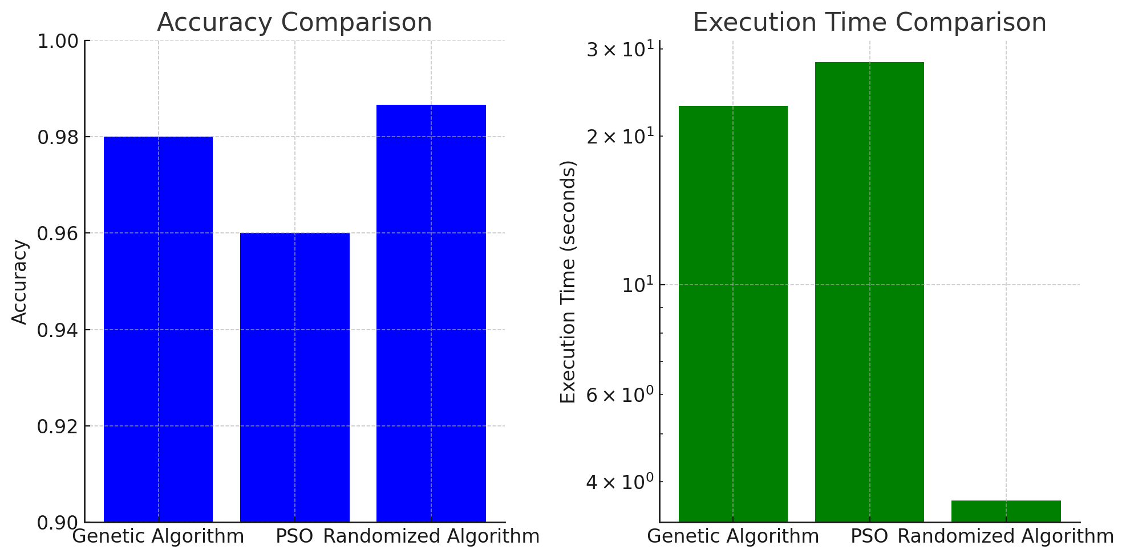
Experiment : GA vs PSO vs Randomized Algorithm
28.19
0.986
0.98
23.01
0.96
3.67

Slide 43
Agenda
Introduction
Motivation
Hyperparameter Optimization Techniques
References

Slide 44
References
On hyperparameter optimization of machine learning algorithms: Theory and practice Li Yang, Abdallah Shami Department of Electrical and Computer Engineering, University of Western Ontario, 1151 Richmond St, London, ON N6A 3K7, Canada https://arxiv.org/abs/2007.15745
Search Algorithms for Automated Hyper-Parameter Tuning Leila Zahedi 1 , 2 , Farid Ghareh Mohammadi 3 , Shabnam Rezapour 4 , Matthew W. Ohland 5 , M. Hadi Amini https://arxiv.org/pdf/2104.14677.pdf
Hyperparameter Optimization Matthias Feurer and Frank Hutter https://link.springer.com/chapter/10.1007/978-3-030-05318-5_1
https://www.youtube.com/watch?v=vnXx7t2pnvQ
https://www.youtube.com/watch?v=DTcfH5W6o08
https://aws.amazon.com/what-is/hyperparameter-tuning/?nc1=h_ls
EFFICIENT HYPERPARAMETER OPTIMIZATION IN DEEP LEARNING USING A VARIABLE LENGTH GENETIC ALGORITHM

